Slide 1
OPTIMIZING TASK OFFLOADING IN AUTONOMOUS VEHICULAR NETWORKS USING MULTI-AGENT REINFORCEMENT LEARNING
Presented By,
Guided By,
Dr. M. Mahil, M.E, Ph.D
Assistant Professor (CSE)

Slide 2
INTRODUCTION
Autonomous vehicles need to process data quickly to drive safely
They perform tasks like:
  Detecting objects
  Making driving decisions
These tasks require high computation, but vehicles have limited resources
So, tasks are offloaded to:
  Nearby edge servers
  Cloud servers
The main challenge is:
  Where to process each task?
A smart decision is needed to reduce delay and save energy

Slide 3
ABSTRACT
Autonomous Vehicles (AVs) generate large amounts of data that must be processed in real time
Due to limited onboard resources, tasks are offloaded to:
Local
  Edge Servers
  Cloud Servers
The main challenge is to decide where to process each task efficiently
This project uses Reinforcement Learning (RL) for intelligent decision-making

Slide 4
ABSTRACT
Three methods are implemented:
  Rule-Based Approach
  Deep Q-Network (DQN)
  Multi-Agent Proximal Policy Optimization (MAPPO)
A realistic simulation is developed using
Simulation of Urban Mobility (SUMO)
Results show that:
  Multi-Agent Proximal Policy Optimization (MAPPO) achieves lowest latency and energy consumption
  Provides best overall system performance

Slide 5
LITERATURE REVIEW
S.NO | JOURNAL | METHODOLOGY | MERITS | DEMERITS
1. | Federated Reinforcement Learning in IoT: Applications, Opportunities and Open Challenges, Applied Sciences, vol. 13, no. 11, p. 6497, June 2023. Authors: E. C. Pinto Neto, S. Sadeghi, X. Zhang, and S. Dadkhah. | Federated Learning (FL) and Reinforcement Learning (RL) | Preserves privacy by sharing only model parameters. Enables collaboration among distributed IoT nodes. | High communication cost between FL and RL layers. No explicit energy optimization mechanism.

Slide 6
LITERATURE REVIEW
S.NO | JOURNAL | METHODOLOGY | MERITS | DEMERITS
2. | Federated Learning-Oriented Edge Computing Framework for the Industrial Internet of Things, Sensors, vol. 24, no. 13, p. 4182, July 2024. Authors: Y. Li, H. Chen, X. Wang, and L. Zhou. | Three-layer Edge–Cloud architecture using FedAvg algorithm | Reduces latency and bandwidth usage. Maintains privacy during collaborative model updates. | Focused mainly on architecture, not predictive maintenance. Did not include reinforcement learning or energy management.

Slide 7
LITERATURE REVIEW
S.NO | JOURNAL | METHODOLOGY | MERITS | DEMERITS
3. | Artificial Intelligence and Edge Computing for Machine Maintenance – A Review, Artificial Intelligence Review, vol. 57, pp. 11823–11859, Jan. 2024. Authors: R. Gupta, A. Singh, and D. Patel. | AI-based models such as CNN, LSTM, and Autoencoders | Strong review linking AI,Edge Computing, and Maintenance. Highlights the advantages of local learning for fast fault detection. | No integration of Federated or Reinforcemet Learning. The study remains theoretical without an implemented energy model.

Slide 8
LITERATURE REVIEW
S.NO | JOURNAL | METHODOLOGY | MERITS | DEMERITS
4. | Aggregation Strategy on Federated Machine Learning Algorithm for Collaborative Predictive Maintenance, IEEE Access, vol. 12, pp. 67124–67139, Aug. 2024. Authors: S. K. Reddy and M. K. Chakraborty. | FL aggregation methods (FedAvg, FedProx, FedSVM) | Provided comparative analysis of FL aggregation algorithms. Demonstrated improved accuracy and communication efficiency. | Energy and task scheduling not considered. Did not include RL or hybrid deep models (LSTM-GRU-Attention).

Slide 9
LITERATURE REVIEW
S.NO | JOURNAL | METHODOLOGY | MERITS | DEMERITS
5. | Using Federated Machine Learning in Predictive Maintenance of Jet Engines, arXiv preprint arXiv:2502.05321, Feb. 2025. Authors: A. M. Barbosa, T. V. N. Ngo, E. Jafarigol, T. B. Trafalis, and E. P. Ojoboh. | Federated LSTM models & FedAvg aggregation | Directly applicable to aerospace maintenance and RUL prediction. Demonstrates FL’s privacy-preserving advantage. | No reinforcement learning or energy optimization. Focused only on FL without task scheduling or communication control.

Slide 10
OBJECTIVE
To develop an intelligent task offloading system for Autonomous Vehicles using Reinforcement Learning.
To minimize latency and energy consumption for efficient task execution
To compare the performance of Rule-Based, Deep Q-Network (DQN), and Multi-Agent Proximal Policy Optimization (MAPPO) methods.
.

Slide 11
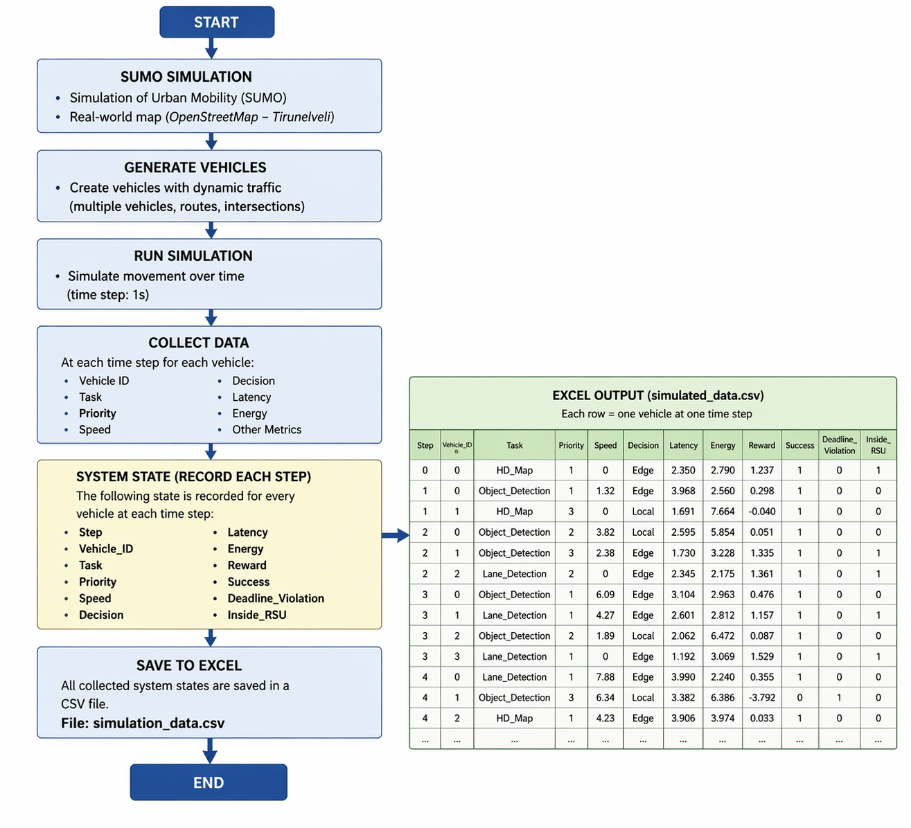
WORKFLOW DIAGRAM

Slide 12
1. SUMO SIMULATION
Simulation of Urban Mobility (SUMO) is a traffic simulation tool used to create a real-world driving environment . In project, I used Tirunelveli city map from OpenStreetMap
The map includes roads, signals, and intersections. This Vehicles are generated with different speeds and routes. Each vehicle moves dynamically and behaves like a real vehicle .
Vehicles continuously generate tasks like object detection , lane detection and HD map display. This helps to test the system in a realistic scenario

Slide 13
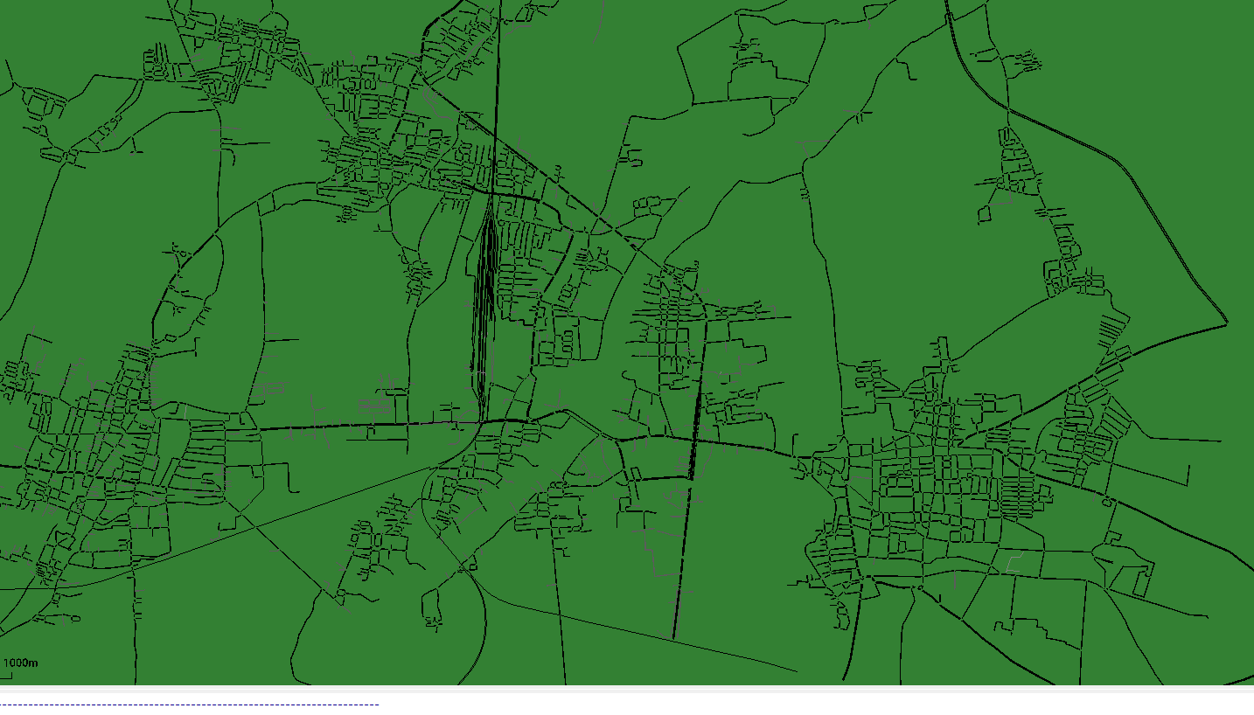
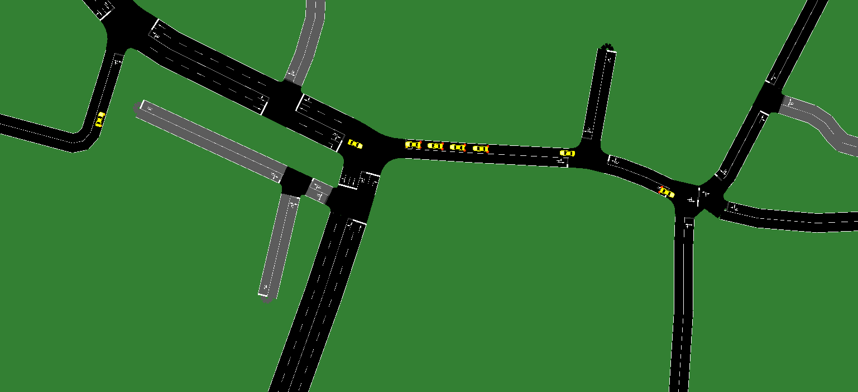
TIRUNELVELI MAP AND CAR GENERATION

Slide 14
2. DATA COLLECTION
Data is collected at every time step from each vehicle and It includes vehicle details like ID, speed, and task type.
The system also records the decision taken (Local / Edge / Cloud)
Performance values like latency and energy are measured
Reward value is calculated based on system performance and It also tracks whether the task is successful or missed deadline
All data is stored in CSV format for analysis

Slide 15
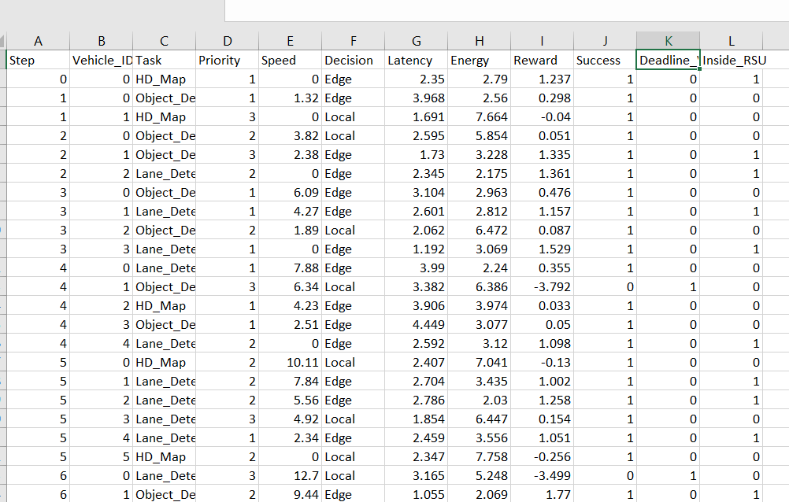
DATA COLLECTION

Slide 16
3. ALGORITHM USED:
Three methods are used to compare performance
Rule-Based method follows fixed rules and does not learn
DQN (Deep Q-Network) learns from experience using neural networks
MAPPO (Multi-Agent Proximal Policy Optimization ) allows multiple vehicles to learn together and MAPPO improves coordination between vehicles
The goal is to find which method performs best

Slide 17
4. TASK OFFLOADING DECESION
Each vehicle must decide where to process its task
The decision is based on system conditions like speed and network
There are three options:
  Local processing inside the vehicle
  Edge server processing (nearby RSU)
  Cloud processing (remote server)
The system selects the best option to reduce delay and energy

Slide 18
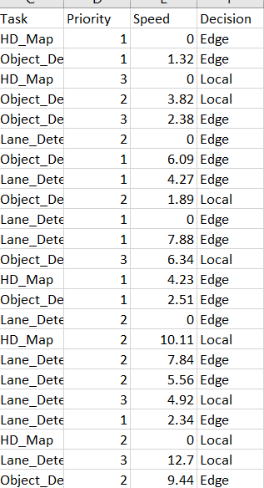

Slide 19
5. PERFORMANCE METRICS
Latency means how much time is taken to complete a task
Energy consumption shows how much power is used
Reward shows overall system performance
Success rate shows how many tasks are completed successfully
Deadline violation shows how many tasks missed the time limit
These metrics help compare different methods

Slide 20
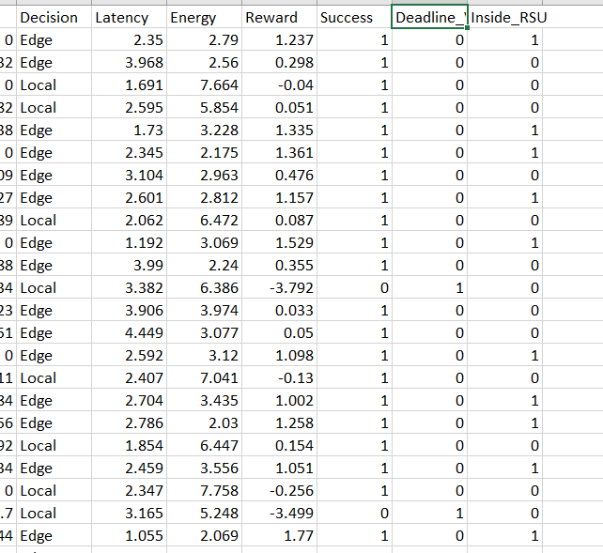
5. PERFORMANCE METRICS

Slide 21
6. FINAL RESULTS
Method | Avg Latency | Avg Energy | Total Reward | Success Rate(%) | Deadline Violation (%)
Rule-Based | 3.612 | 3.319 | -1120439.98 | 81.72 | 18.28
DQN | 2.539 | 4.111 | -39882.65 | 78.94 | 21.06
MAPPO | 2.436 | 3.243 | 3050.95 | 76.10 | 23.90

Slide 22
6. FINAL RESULTS
Multi-Agent Proximal Policy Optimization (MAPPO) gives lowest latency (2.436)
MAPPO gives low energy consumption (3.243)
MAPPO achieves positive reward (3050.95)
Rule-Based gives highest success rate (81.72%)
MAPPO has slightly lower success rate (76.1%)
MAPPO has higher deadline violation (23.9%)
But overall, MAPPO performs best

Slide 23
RESULT JUSTIFICATION
RULE-BASED APPROACH
How it works
The rule-based method makes decisions using fixed conditions (if-else rules).
logic:
If latency is high → offload to edge
If edge is busy → send to cloud
Otherwise → process locally

Slide 24
RESULT JUSTIFICATION
high success
  Always chooses safe decisions
  Prioritizes completing tasks
high latency
  Decisions are not optimized
  May send tasks to slower resources
very negative reward
  High latency + energy → large penalty

Slide 25
RESULT JUSTIFICATION
DQN (Deep Q-Network)
How it works
  DQN is a single-agent reinforcement learning algorithm.
Steps:
Observe current state
Choose action (local/edge/cloud)
Get reward
Update Q-values using neural network
Learns from experience over time.

Slide 26
RESULT JUSTIFICATION
Output
Latency: 2.539 (BETTER )
Energy: 4.111 (HIGH )
Reward: -39882.65 (IMPROVED but negative)
Success: 78.94% (OK)
Deadline: 21.06% (MEDIUM

Slide 27
RESULT JUSTIFICATION
lower latency
  Learns faster execution decisions
higher energy
  overuse edge/cloud resources
reward still negative
  Still not fully optimized
  Balancing problem not solved
moderate success
  Better than random but not stable

Slide 28
RESULT JUSTIFICATION
MAPPO (Multi-Agent PPO)
How it works
MAPPO is a multi-agent reinforcement learning algorithm.
Key idea:
  Each vehicle = agent
  All agents learn together (centralized training)
  But act independently (decentralized execution)
Uses:
  Policy optimization
  Shared critic (global knowledge)

Slide 29
RESULT JUSTIFICATION
Latency: 2.436 (LOWEST )
Energy: 3.243 (LOWEST )
Reward: 3050.95 (BEST )
Success: 76.1% (LOWER)
Deadline: 23.9% (HIGHER)

Slide 30
lowest latency?
  Agents coordinate decisions
  Avoid congestion
Lowest energy?
  Efficient resource usage
positive reward?
  Best balance of all metrics
lower success rate and higher deadline violation
  Does NOT focus only on completion
  Optimizes overall system
  Sometimes drops/delays tasks
  Chooses efficiency over strict completion

Slide 31
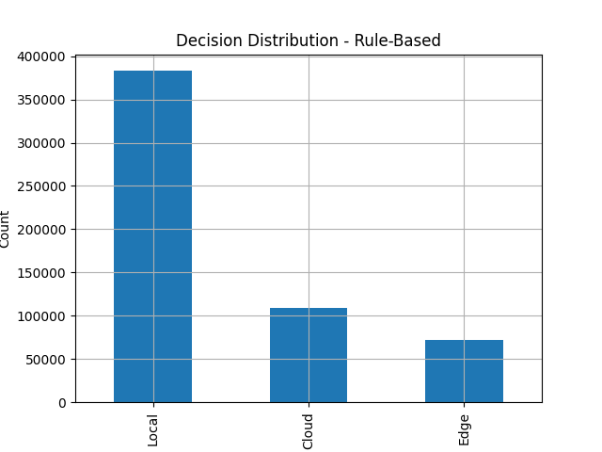
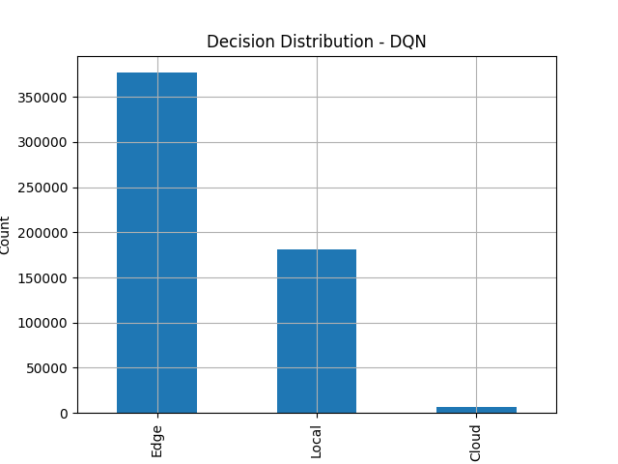
7. DECISION DISTRIBUTION

Slide 32
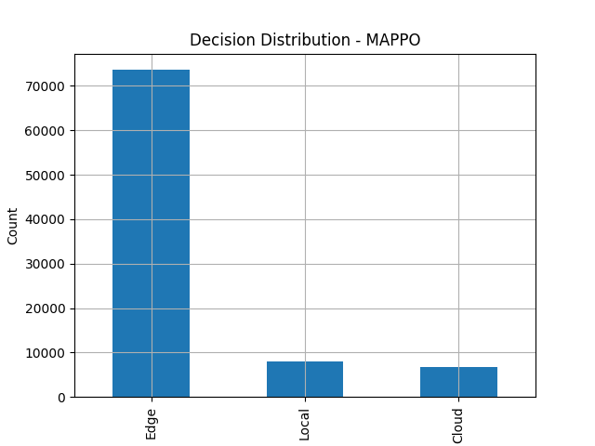
7. DECISION DISTRIBUTION
This graph shows how often each method selects Local, Edge, or Cloud
Rule-Based method mostly follows fixed patterns
DQN tries different options and learns over time
MAPPO balances all options efficiently .It avoids overusing one resource and This shows how smart the decision-making .

Slide 33
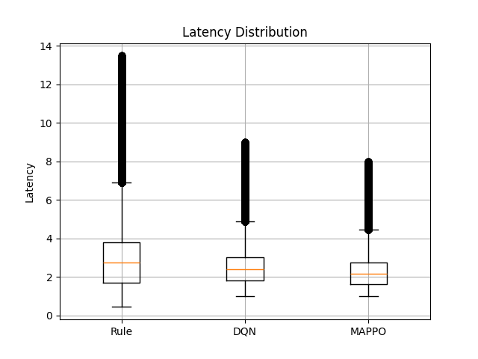
8. LATENCY ANALYSIS: BOXPLOT

Slide 34
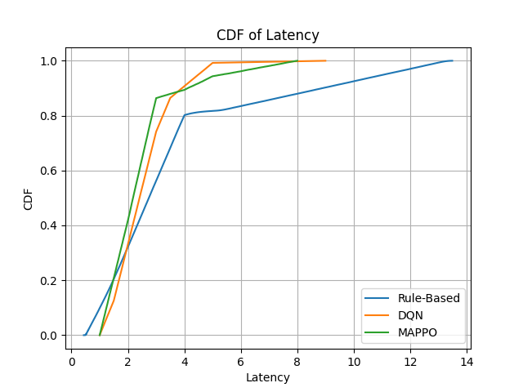
LATENCY ANALYSIS: CDF

Slide 35
LATENCY ANALYSIS
This graph shows delay in task execution
Boxplot shows variation in latency
CDF shows how fast tasks are completed
Rule-Based has higher delay
DQN reduces delay but is not stable
MAPPO gives lowest and more stable latency .This means faster task execution

Slide 36
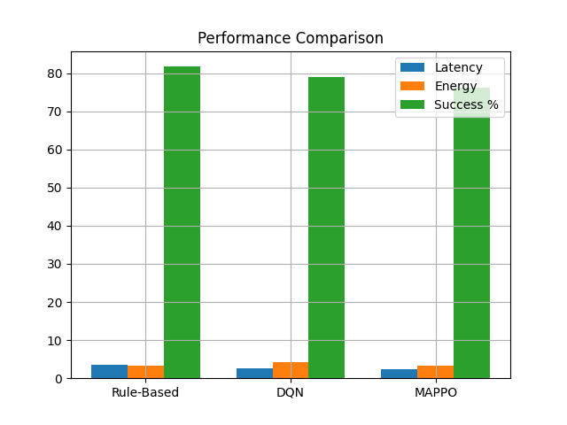
9. PERFORMANCE COMPARISON
This graph compares latency, energy, and success rate
Rule-Based gives high success but poor efficiency
DQN improves latency but uses more energy
MAPPO gives best balance between all metrics. It reduces delay and energy together
This shows overall system improvement

Slide 37
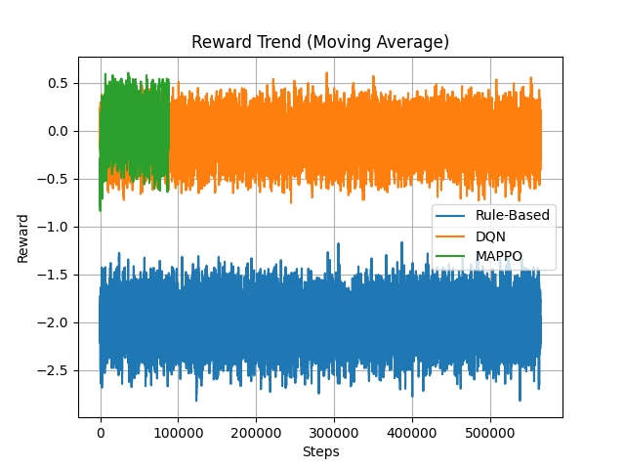
10. REWARD ANALYSIS
Reward represents overall performance
It combines latency, energy, and success
Rule-Based has very high negative reward
DQN improves reward but still negative
MAPPO gives positive reward and this shows MAPPO learns better decisions

Slide 38
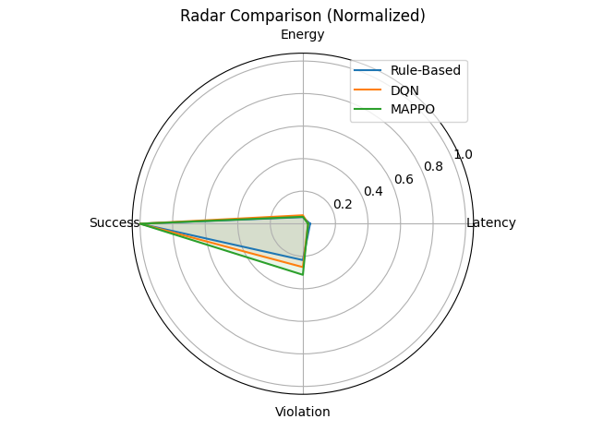
11. RADAR CHART
This graph shows all metrics in one view
Each axis represents one performance metric
Rule-Based is strong only in success rate
DQN is moderate in all metrics
MAPPO shows balanced performance and It performs well in all areas

Slide 39
THANK YOU

